Slide 1
Use of S-NPP Data in Navy/DoD Operations
NRL
Jeremy Solbrig, Ben Ruston, Jeff Hawkins, Arunas Kuciauskas, Rich Bankert, Kim Richardson, Mindy Surratt
CIRA
Steve Miller
Naval Research Laboratory
Marine Meteorology Division

Slide 2
Operational Use of S-NPP
Currently assimilating ATMS operationally
CrIS assimilation under development
Producing VIIRS imagery products globally
Public Webpages:
www.nrlmry.navy.mil/NEXSAT.html
www.nrlmry.navy.mil/VIIRS.html
http://www.nrlmry.navy.mil/tc_pages/tc_home.html

Slide 3
Operational Assimilation of S-NPP ATMS
ATMS is treated as a primary sensor and has a first priority weighting along with MetOp-B, DMSP-F18, and NOAA-18.
The ATMS data are thinned to ~135km before assimilation
In addition to quality flags in the data itself; a sea ice, cloud liquid water and scattering index is generated and applied to water vapor and tropospheric temperature channels
Operational bias correction is variational; however, a Harris-Kelley offline type is available
Operational with NAVGEM v1.2 [1QFY14]; though technology was transferred with NAVGEM v1.1 [2QFY13] data feed to operations was delayed.

Slide 4
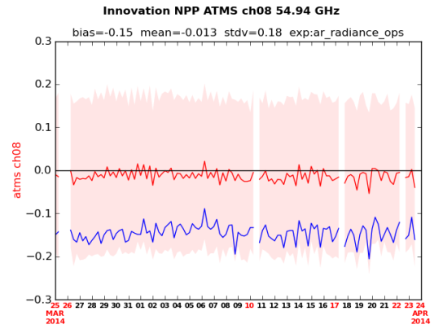
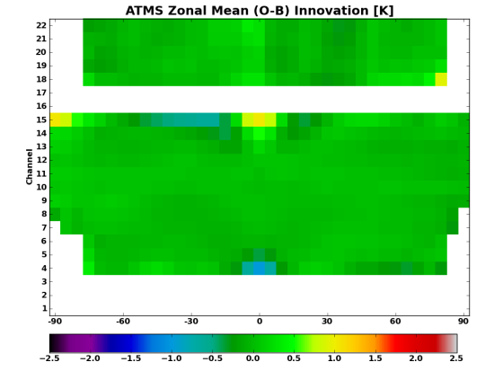
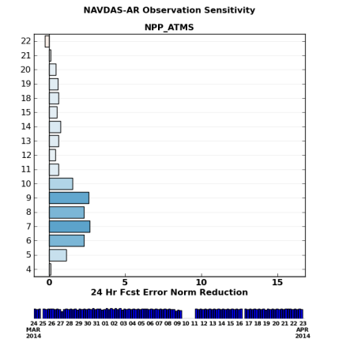
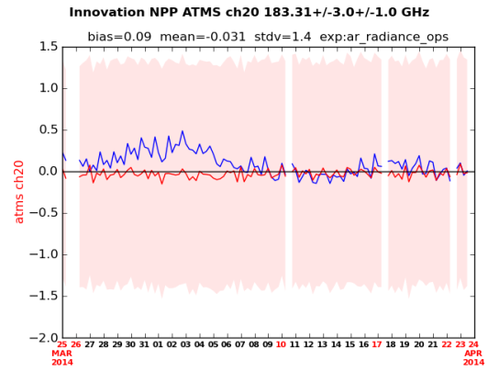
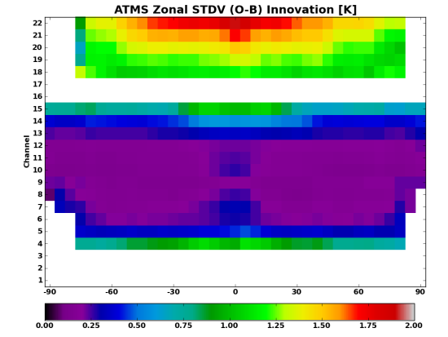
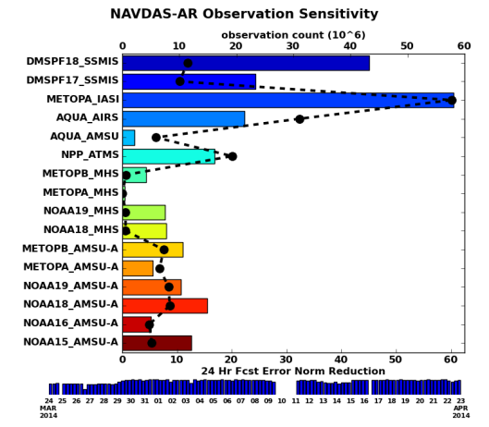
Operational Assimilation of ATMS
Monitoring of operational data streams at FNMOC
http://www.nrlmry.navy.mil/metoc/ar_monitor/
Radgrams
Global mean and stdv of innovation
Zonal Innovation
Latitudinal dependence of mean and stdv
Observation Impact
Reduction of NWP error due to observation
Notes:
O – observation
B – Forecast synthetic observation
Blue line – Un bias corrected
Red – Bias corrected
Left panel shows that the departure from O is minimal. 0.2K variance and mean near 0K.
Everything done in ob space.
Middle:
Same as red line, but for each channel and calculated zonally. Top few channels are water vapor channels. Others are temperature channels.
Right:
Top: Channel impact – 22 is stratospheric moisture and is used. Problems with calculating relative humidity.

Slide 5
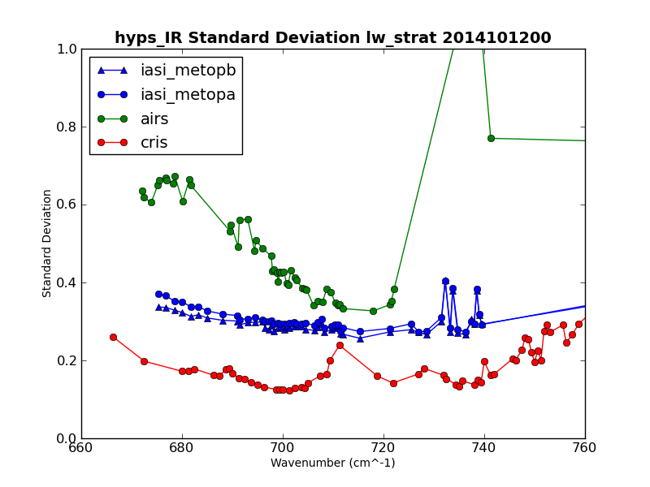
Assimilation of CrIS
CrIS is first U.S. interferometer since IRIS-D on Nimbus 4 [1970].
Data received is 1317 unapodized channels which are apodized resulting in a 1305 channel set.
The CrIS data are thinned to ~135km before assimilation
Examining 239 channels for assimilation, 108 longwave CO₂ and 131 water vapor.
CrIS has been evaluating well in testing and exhibits lower noise than IASI or AIRS, see figure to the right showing standard deviations of longwave CO₂ channels.
Transition planned for NAVGEM v1.3.1 [4QFY15]

Slide 6
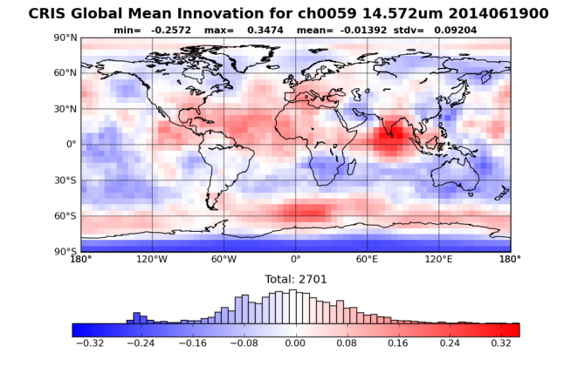
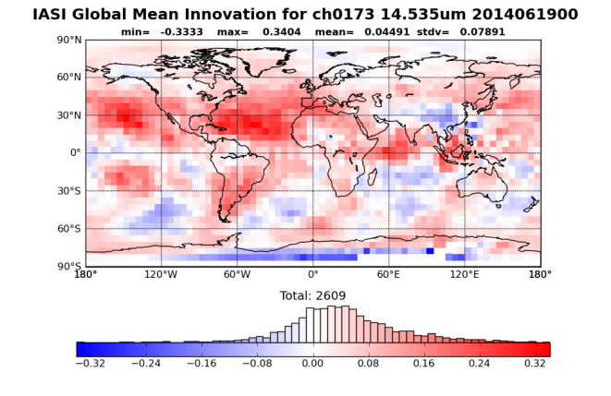
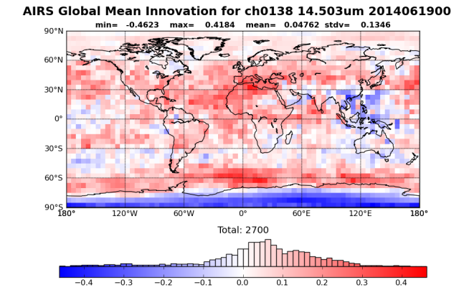
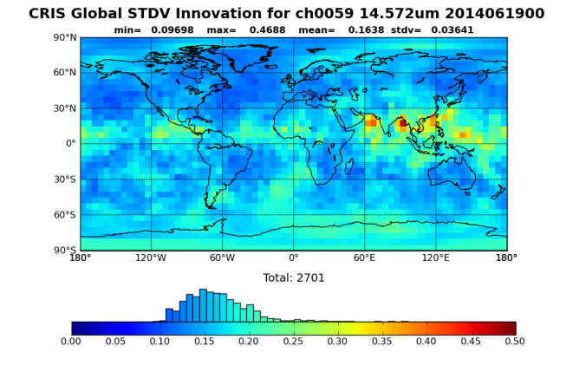
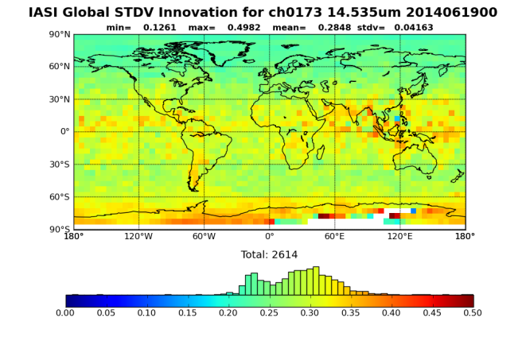
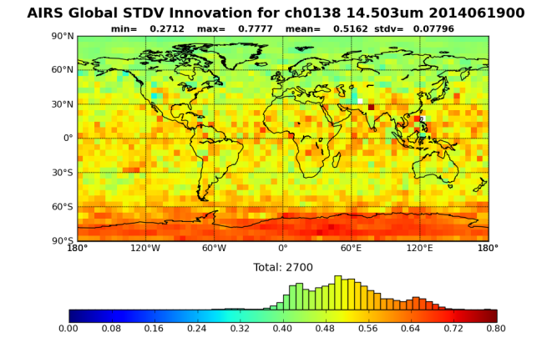
Assimilation of CrIS
Innovation statistics for 5x5-degree boxes over 8-days (32 update cycles)
Three similar IR longwave CO₂ channels again show the good noise performace of CrIS (lowest STDV in bottom row)
Quality control, mainly cloud contamination, is being finalized residual effects are seen in the cold tail in the histogram of the CrIS mean and the high CrIS standard deviation in the tropics.
Mean
Std Deviation
Notes:
Longwave CO2 channels
Innovations for individual channels.
Cold tail in first figure is cloud. Has been fixed recently.
Red in lower first figure is also cloud.

Slide 7
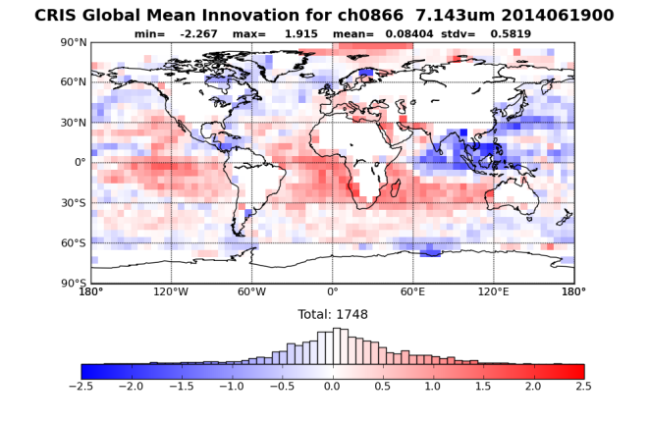
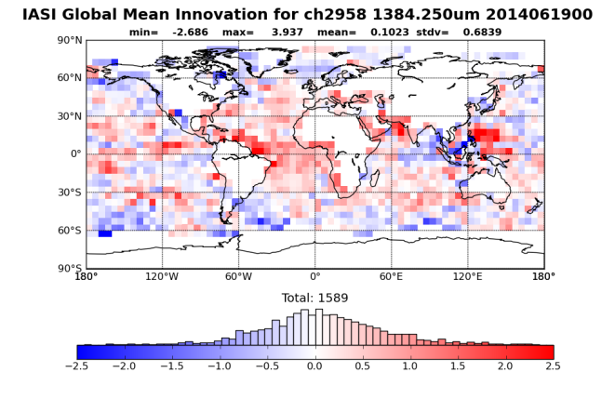
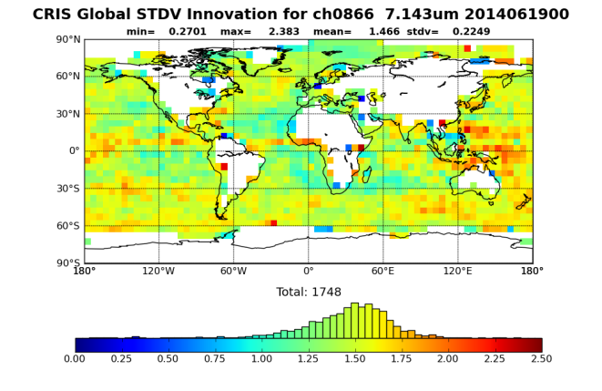
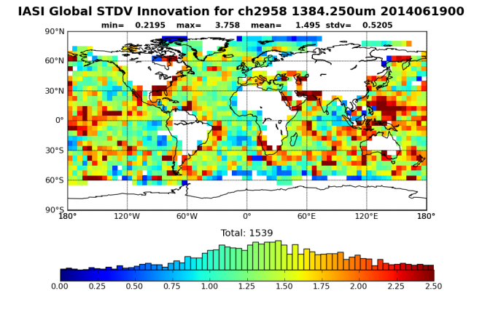
Assimilation of CrIS
Innovation statistics for 5x5-degree boxes over 8-days (32 update cycles)
Two similar IR water vapor channels
AIRS water vapor assimilation under development.
Only ocean points are assimilated.
7.224
Performance of CrIS is qualitatively very good, initial observation impact using adjoints of NWP and assimilation system show greater impact from CrIS water vapor than from IASI.
Mean
7.224
Std Deviation
Notes:
Water vapor channels – AIRS does not have one
CrIS seems to have lower noise. According to ob sensitivity metrics, we see higher impact from water vapor channels from CrIS than IASI.

Slide 8
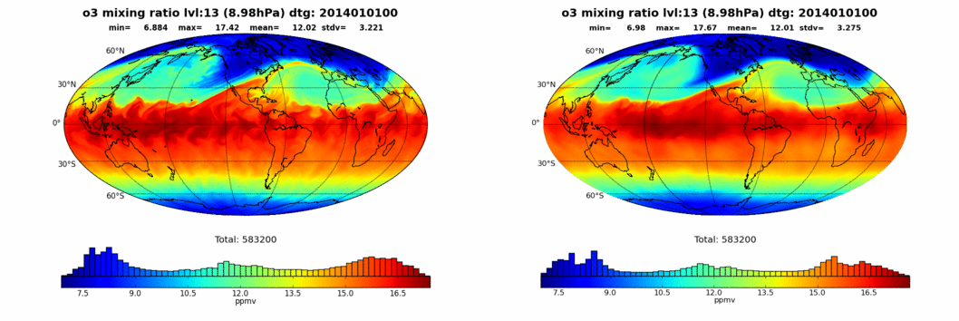
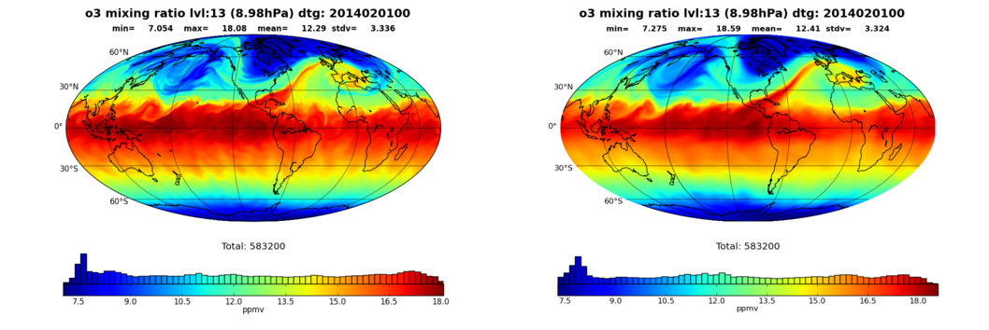
Ozone Assimilation (OMPS)
Tracer Assimilation: Ozone profiles from SBUV/2 and OMPS
NEW - With Ozone Assimilation
OLD - NOAA Initialization
Add Tracer Assimilation capability for passive species.
Implemented for Ozone retrievals from SBUV/2 and Suomi NPP-OMPS.
Technology transferred in 4QFY14 with NAVGEM v1.2.1; inactive due to a missing photochemical process in NWP model, process to be added in NAVGEM v1.3.1 [4QFY15].
Notes:
Note the distribution, mean and standard deviation of the Ozone is similar between assimilation and NOAA initialization. The effect of the missing photochemical process is at ~ 1hPa which is above the Ozone peak (30-10hPa). The lack of the processes causes satellite swaths to appear in the Ozone fields at 1hPa and above as the diurnal variation in Ozone doesn’t exist in the model.
Woud like to trun on OMPS assimilation in the near future so that we can quit waiting for NCEP model output. NCEP uses SBUV-2 which gives a swath. OMPS only provides a pencil beam. Output using OMPS is very similar to the NCEP model output.
Currently in ops. Just needs to be turned on.

Slide 9
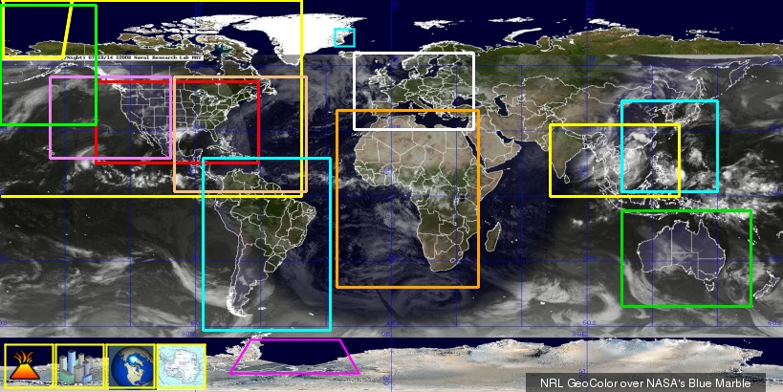
VIIRS Imagery
NexSat
TCWeb
VIIRS Demo

Slide 10
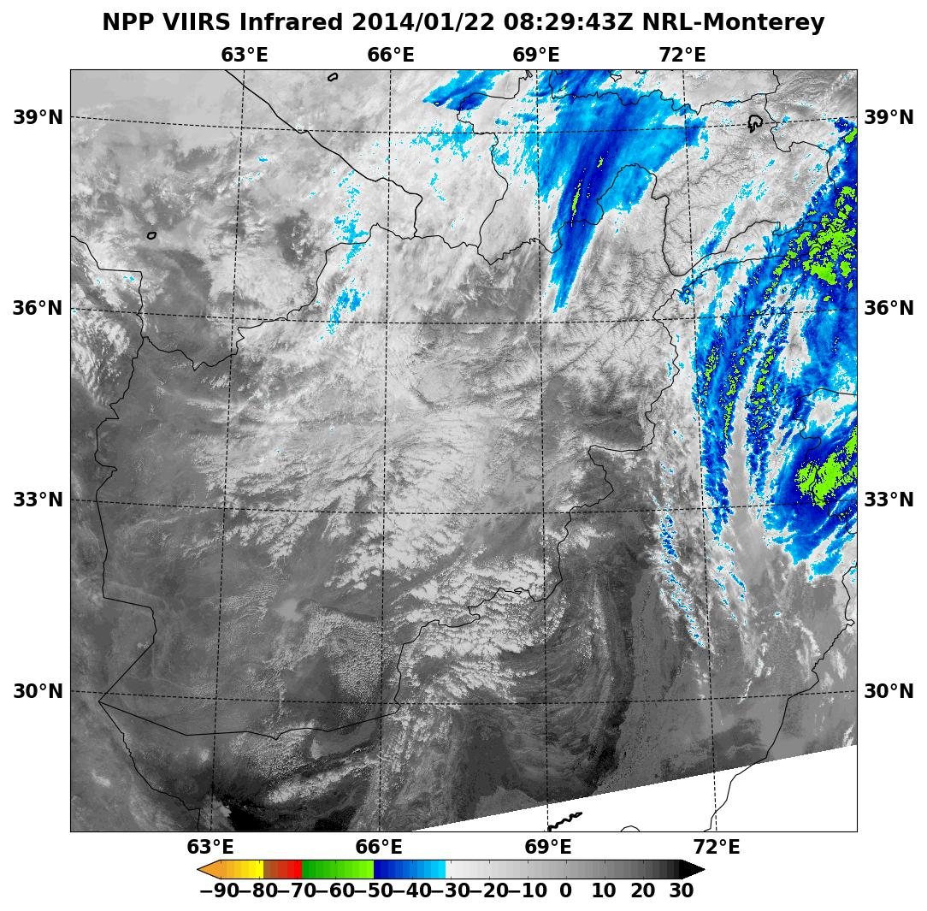
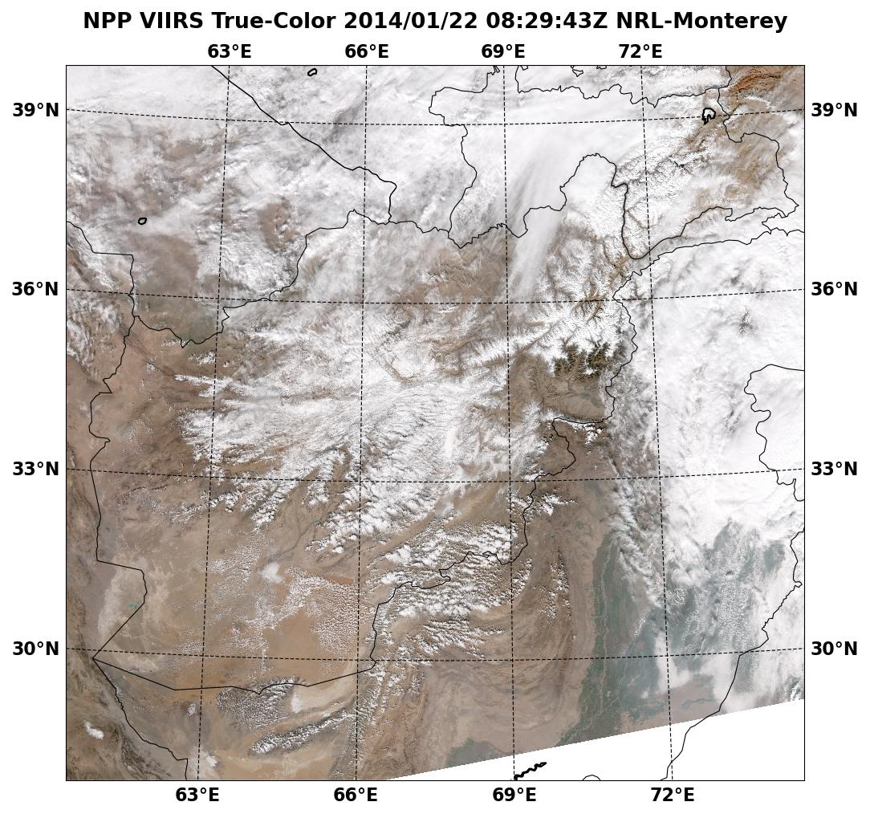
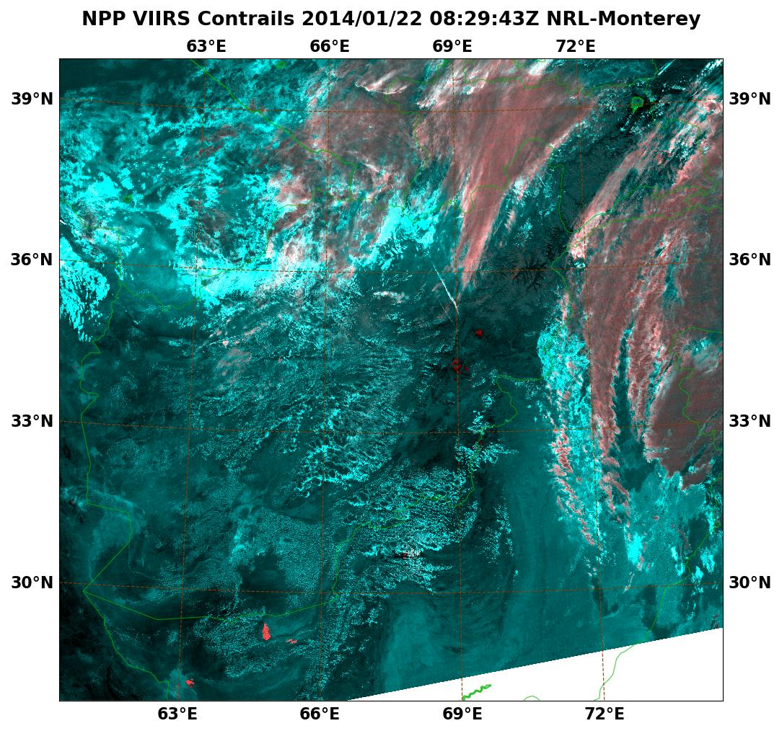
VIIRS Contrail Detection
GOAL: Enable detection and tracking of flight patterns. Indication of where contrails may form.
False Color Enhancement for contrails:
R: 8.55 µm – 11.0 µm
G: 11.0 µm – 12.0 µm B: 11.0 µm – 12.0 µm
Transitioned to Operations
Afghanistan

Slide 11
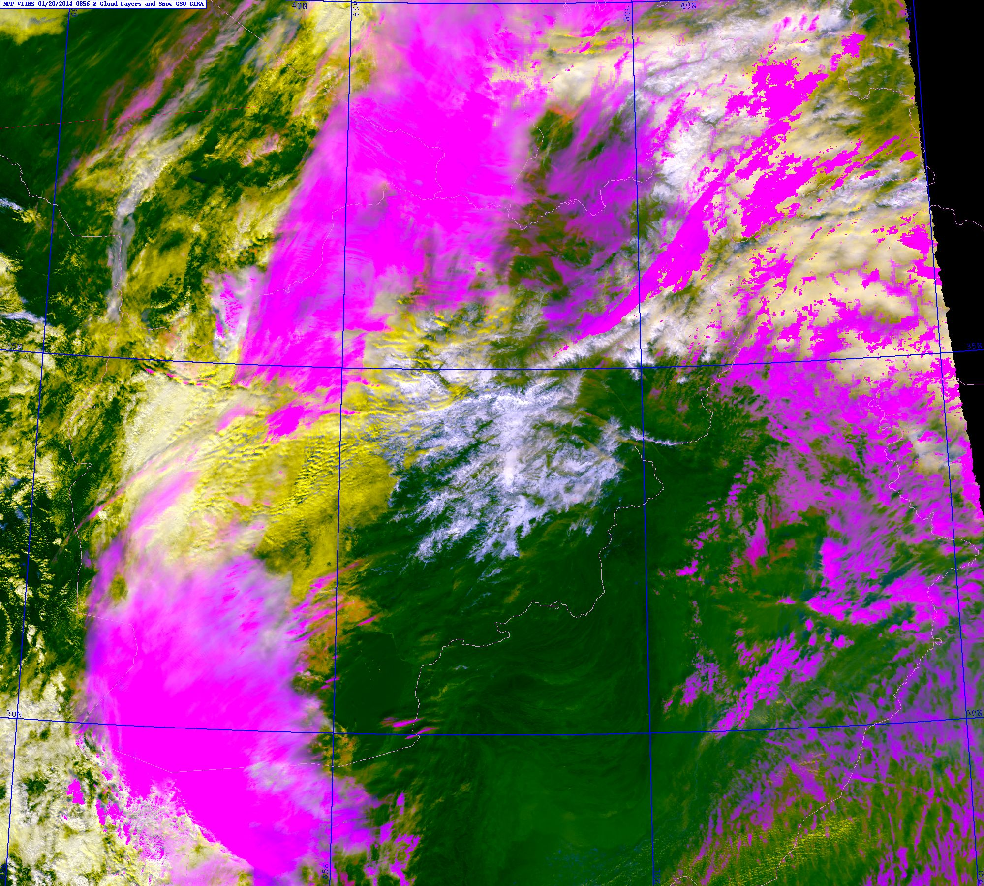
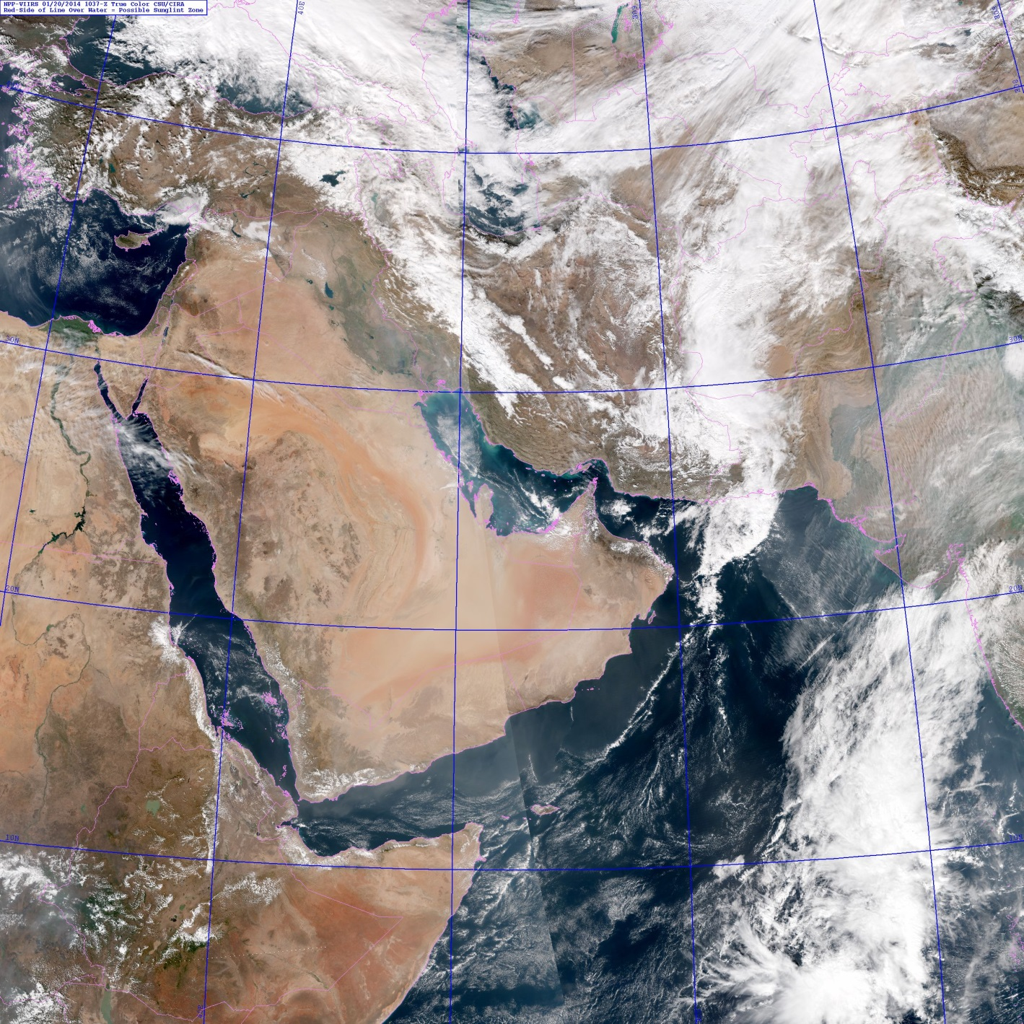
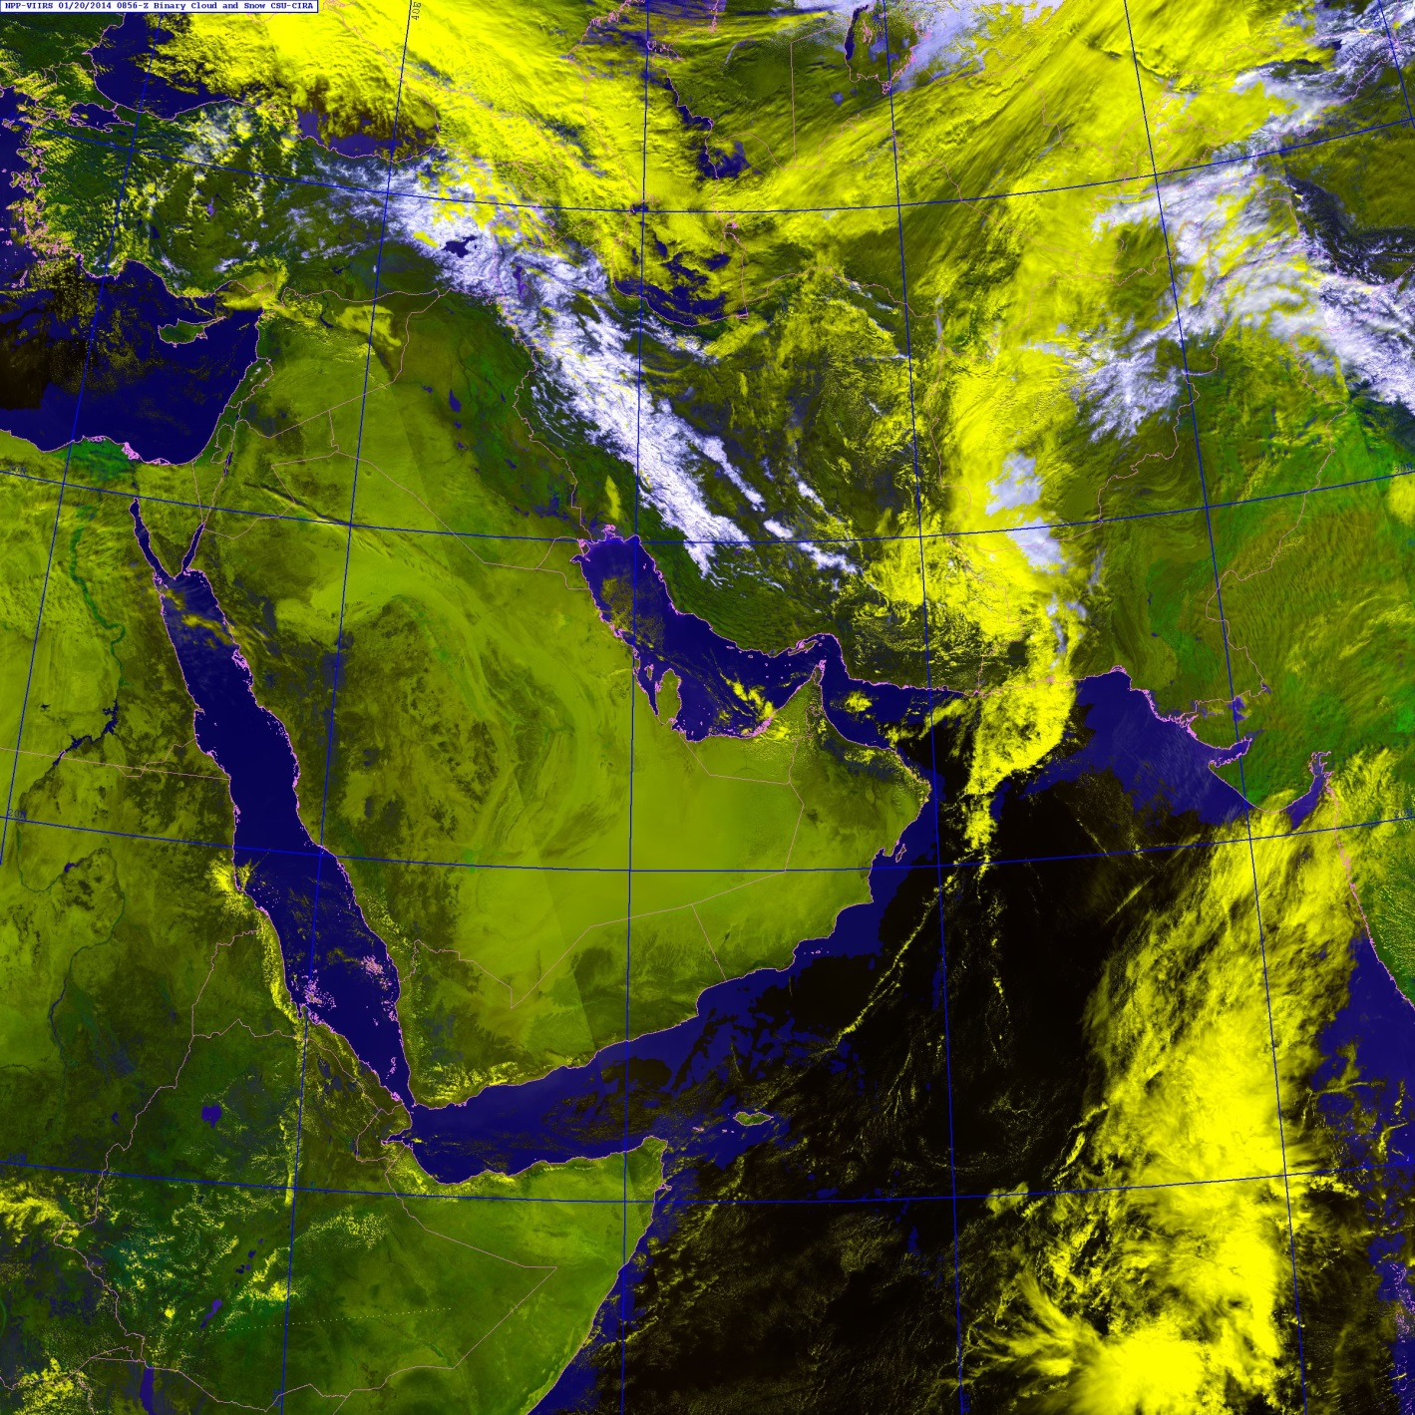
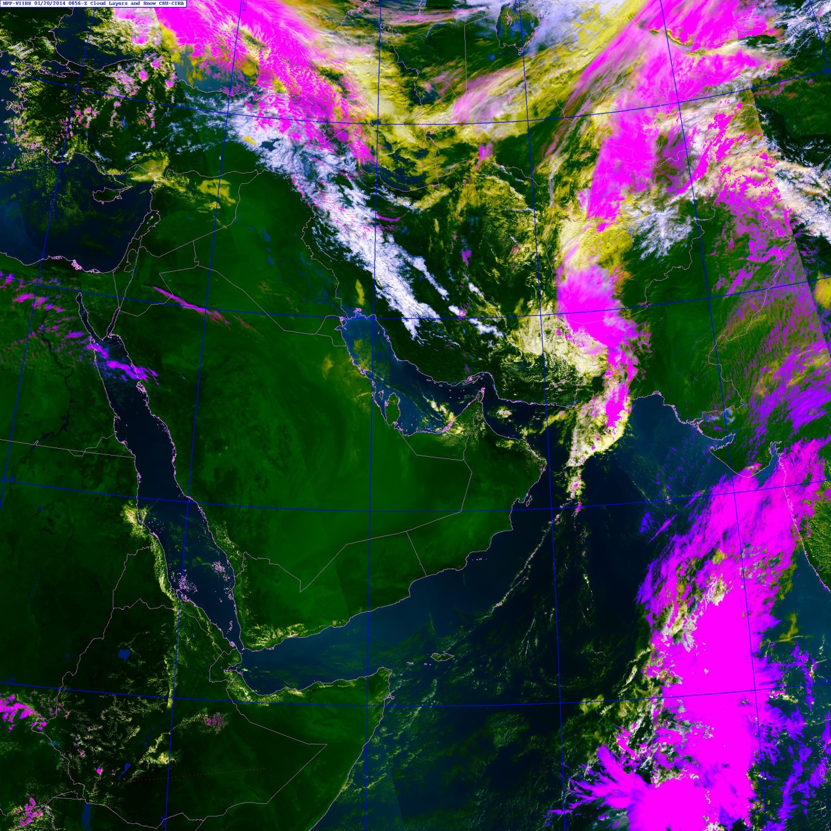
VIIRS Cloud/Snow Discrimination
20 Jan 2014
Binary Cloud/Snow:
R: .865 µm (Near IR)
G: .672 µm (Visible)
B: Reflectance difference of .672 µm and 1.6 µm (strong snow; weak cloud/land)
GOAL: Improve analyses over complex cloud/snow scenes – useful for trafficability assessment.
Cloud Layers/Snow:
Uses a combination of visible (.488 µm and .672 µm), “Ci channel” (1.38 µm), SW IR (1.61 µm and 2.25 µm), and LW IR (11.0 µm) channels in false color enhancement.
→ White snow, yellow low clouds, magenta high clouds

Slide 12
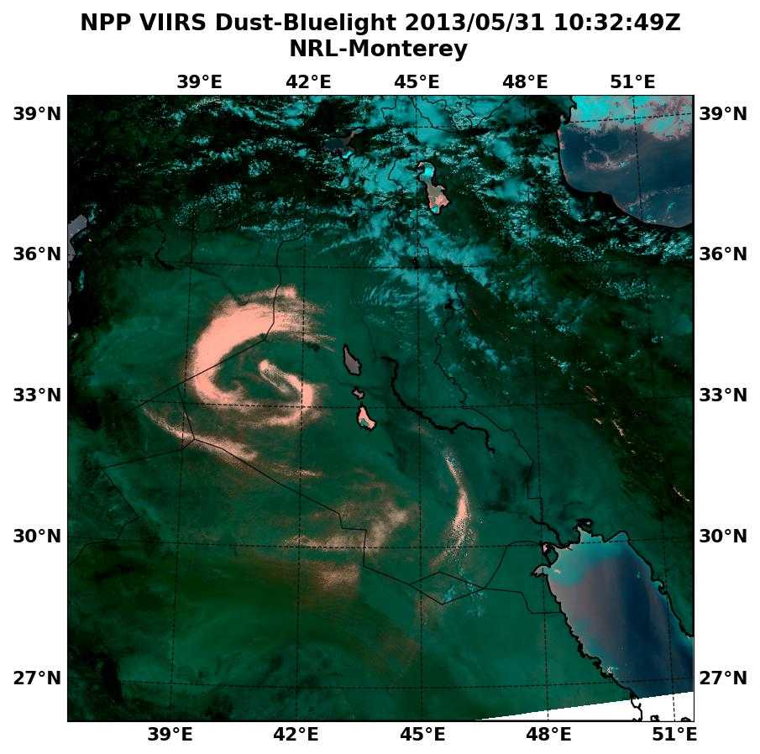
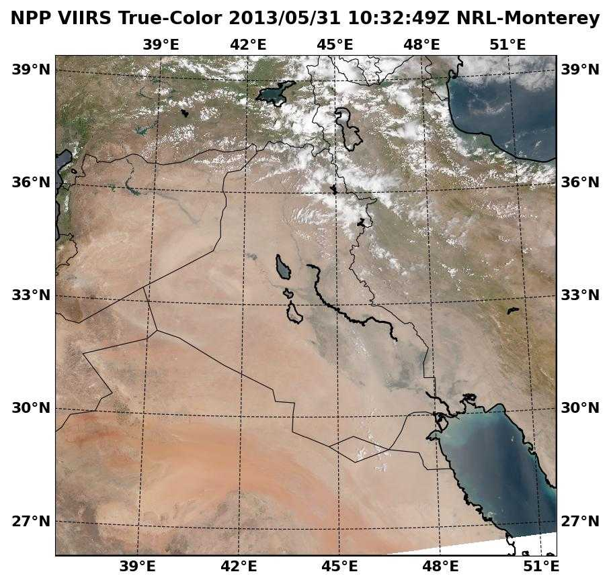
VIIRS (Blue-Light) Dust
GOAL: Enhance and isolate lofted dust over desert (daytime) to reduce or avoid the problems associated with limited visibility in airborne dust.
NRL Dust Enhancement Algorithm uses a multispectral (7-band) function that takes advantage of these dust properties:
Higher blue light absorption for dust
Thermal contrast (dust and surface)
IR split window difference (opposite in sign to Ci)
A false-color enhancement is created to isolate the lofted dust:
R: 7-band function (VIS/NIR/TIR)
G: Rayleigh-corrected green band
B: Rayleigh-corrected blue band
IRAQ
Transitioned to Operations

Slide 13
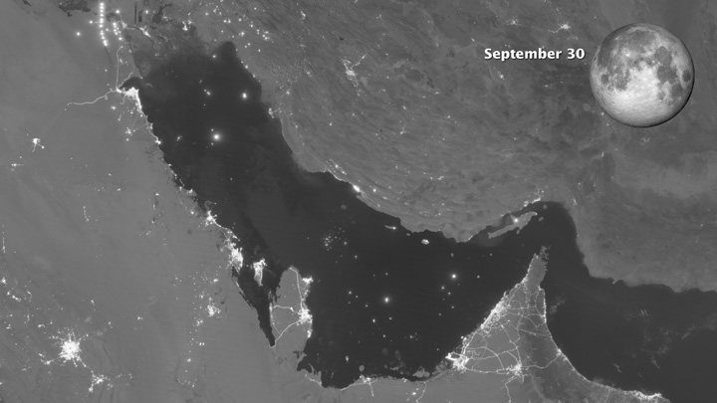
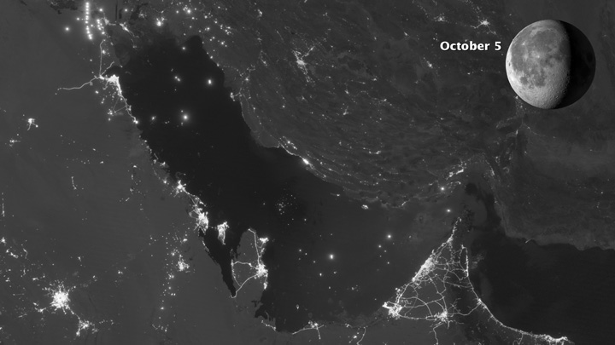
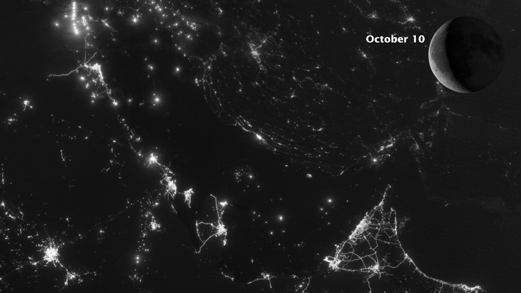
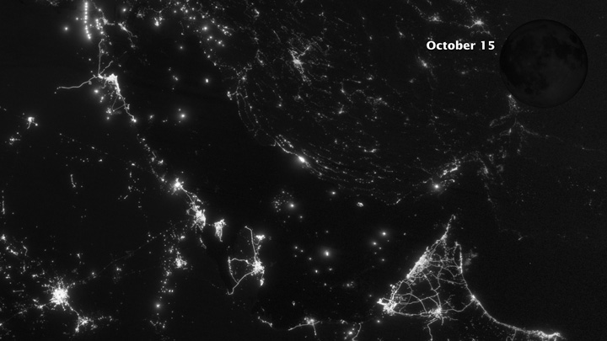
The Lunar Cycle Sep 30 – Oct 15 2012
Iran
Saudi Arabia

Slide 14
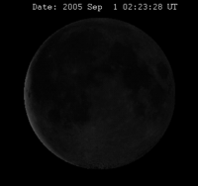
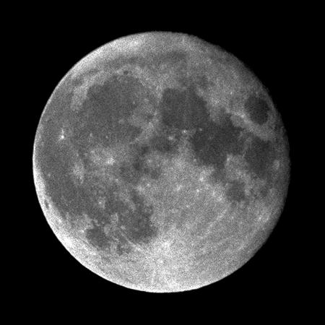
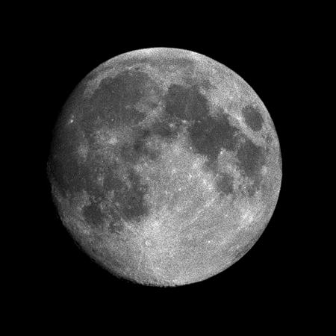
The Lunar Cycle
9 Aug 1987 1900 UTC
2 Feb 1988 1600 UTC
Perigee: 357,643 km
Apogee: 406,395 km

Slide 15
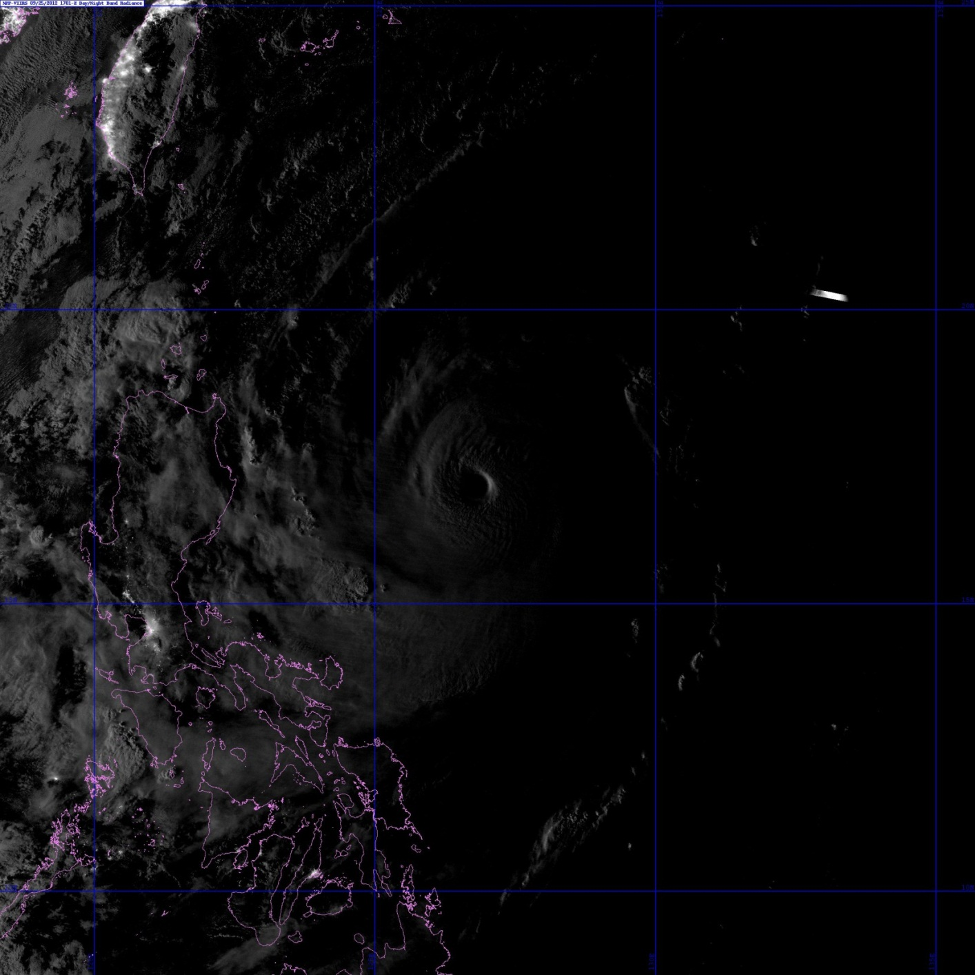
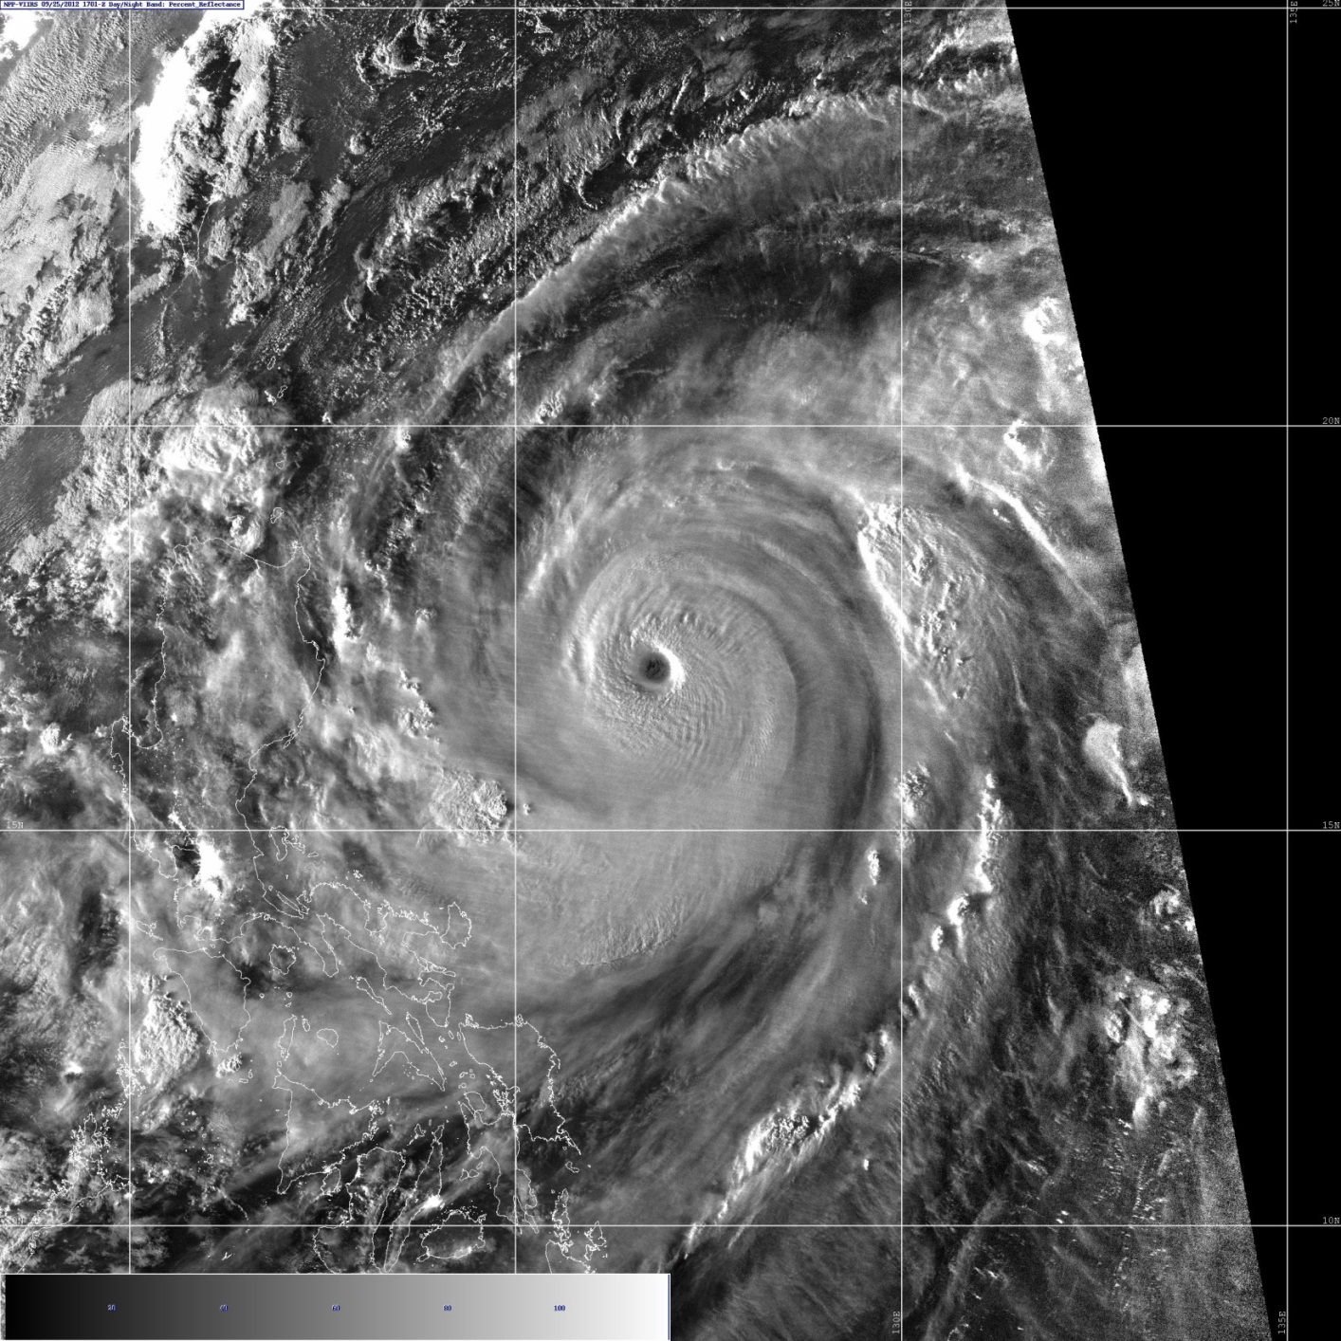
Quantitative Lunar Reflectances
Lunar model is used to produce a form of near constant contrast (NCC) imagery.
Not applicable to the day/night terminator where solar signal is present.
Moon phase: 80%
Cut off line for lunar model
Manila
city lights
Quantitative visible reflectance values: many applications

Slide 16
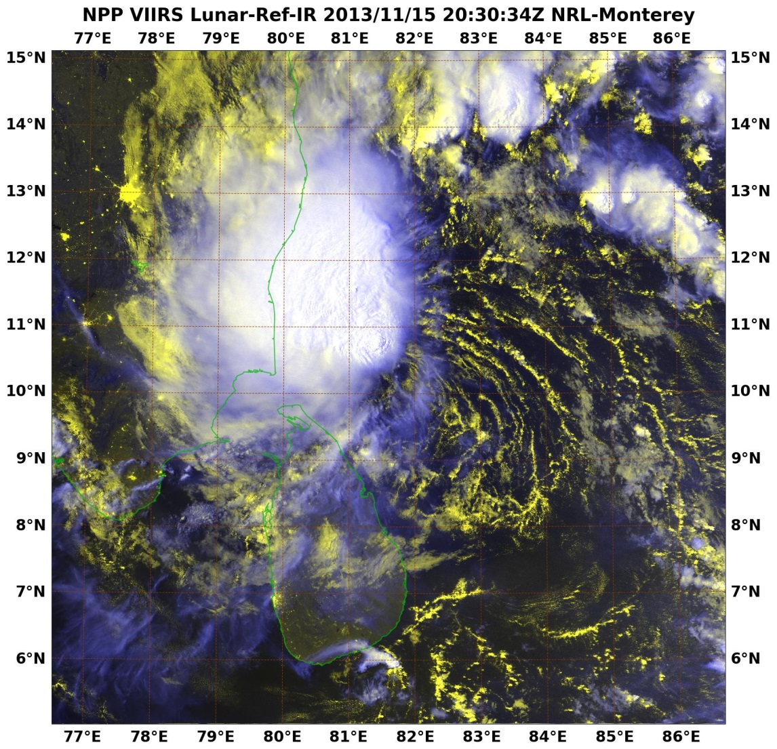
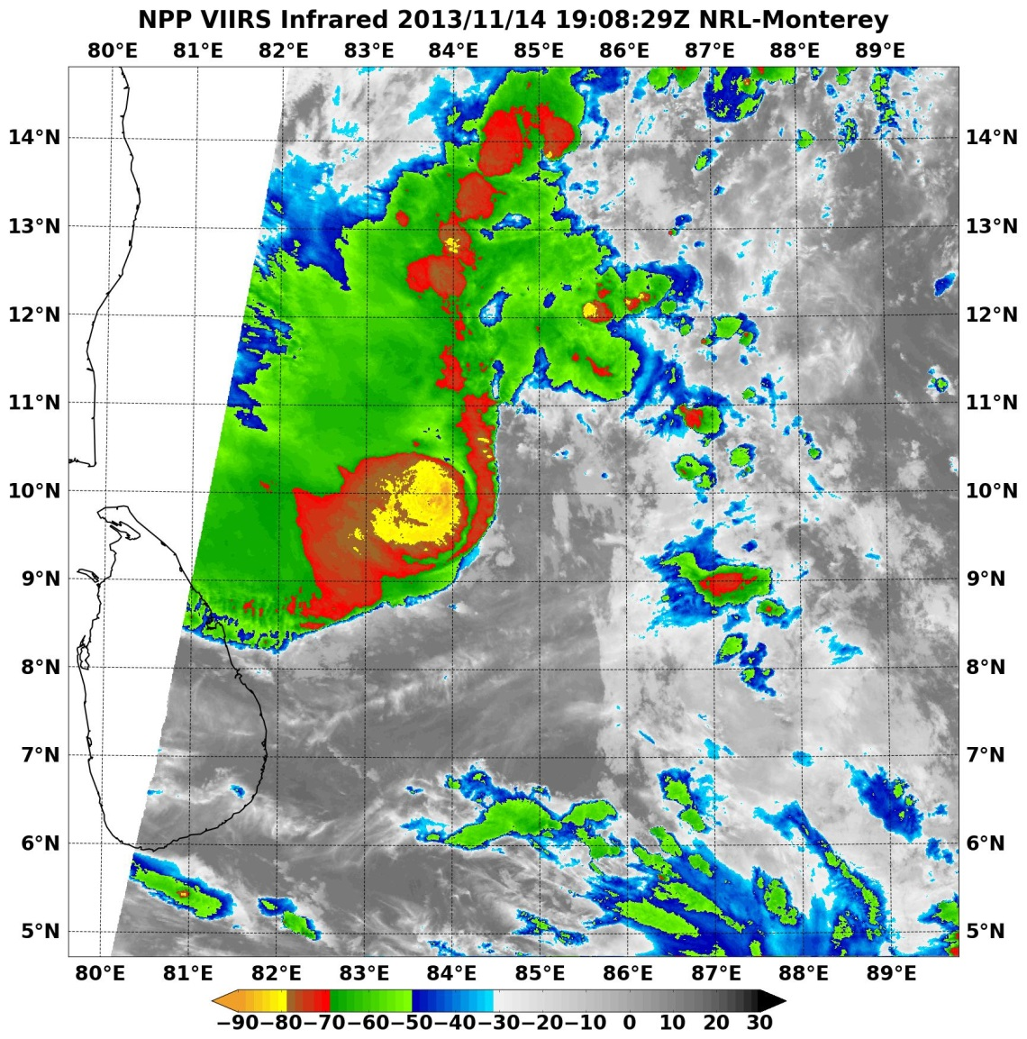
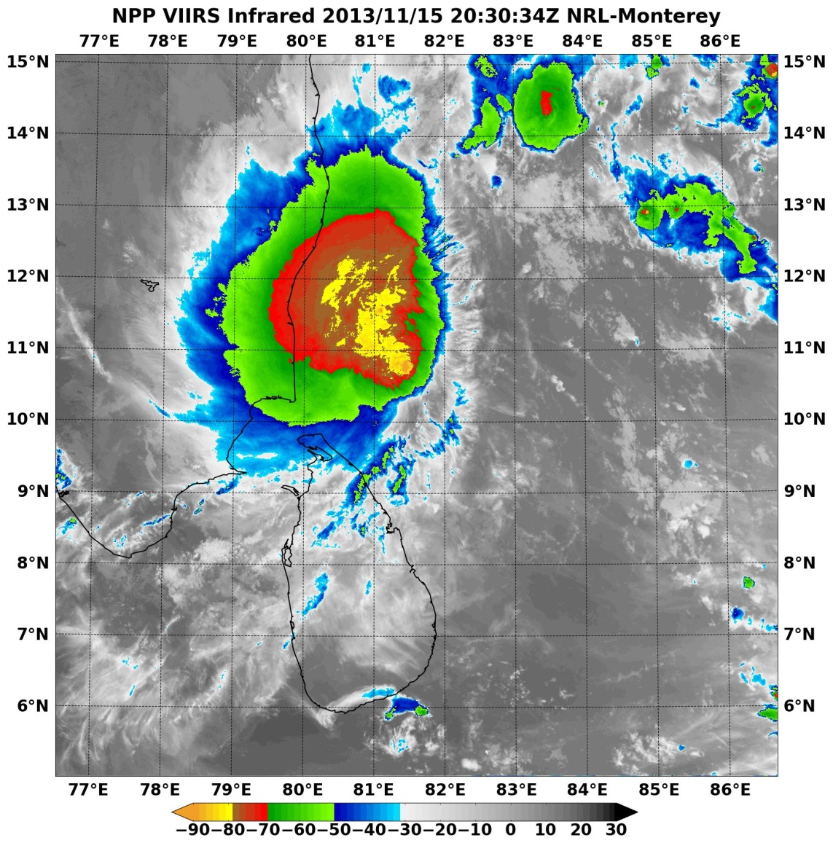
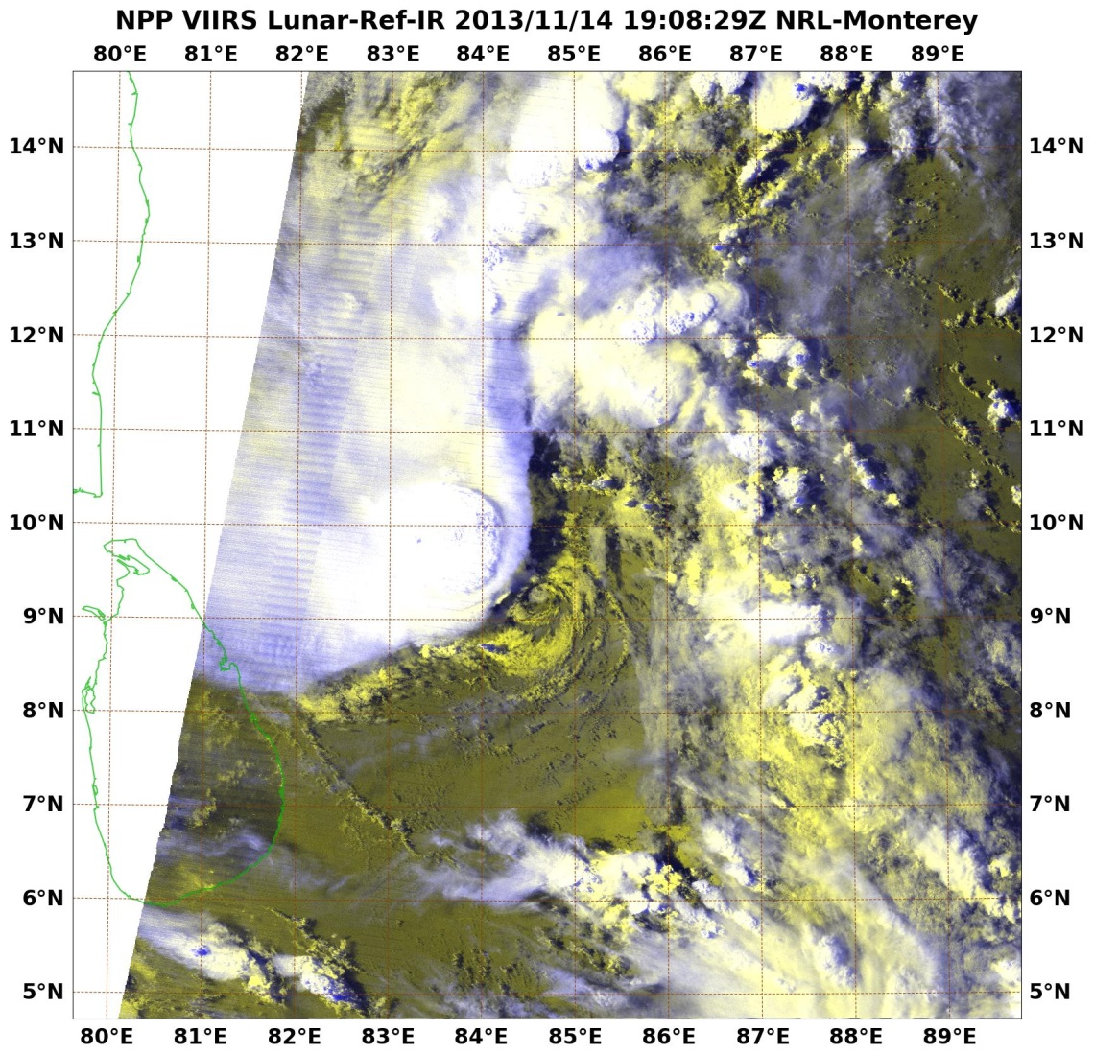
DNB Reveals Low-Level Features
LLCC “exposed” by VIIRS DNB lunar illumination

Slide 17
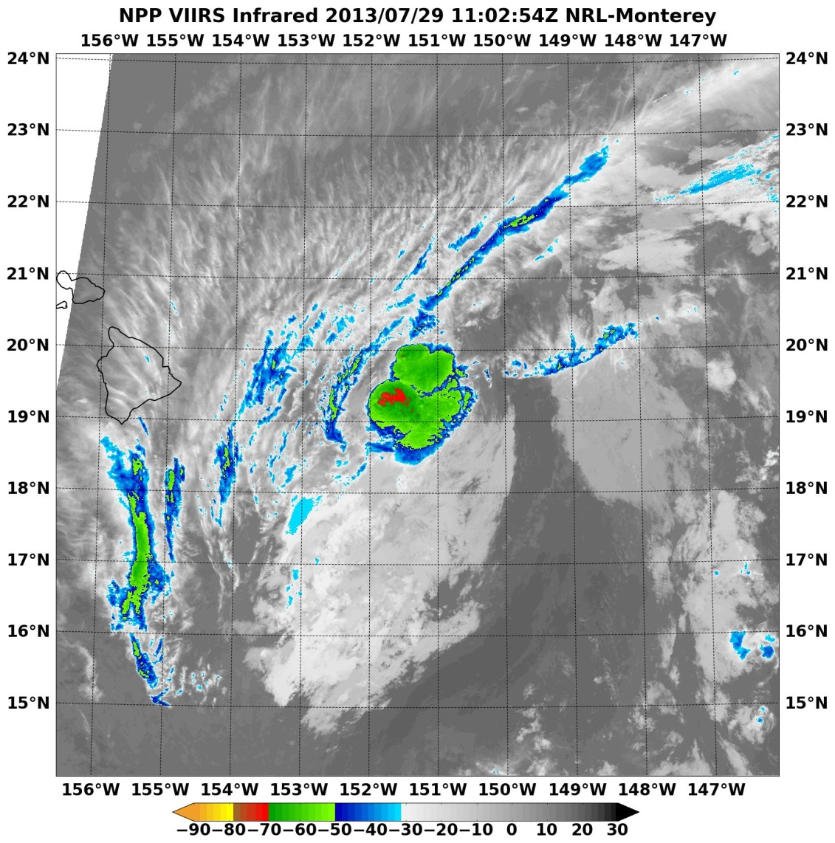
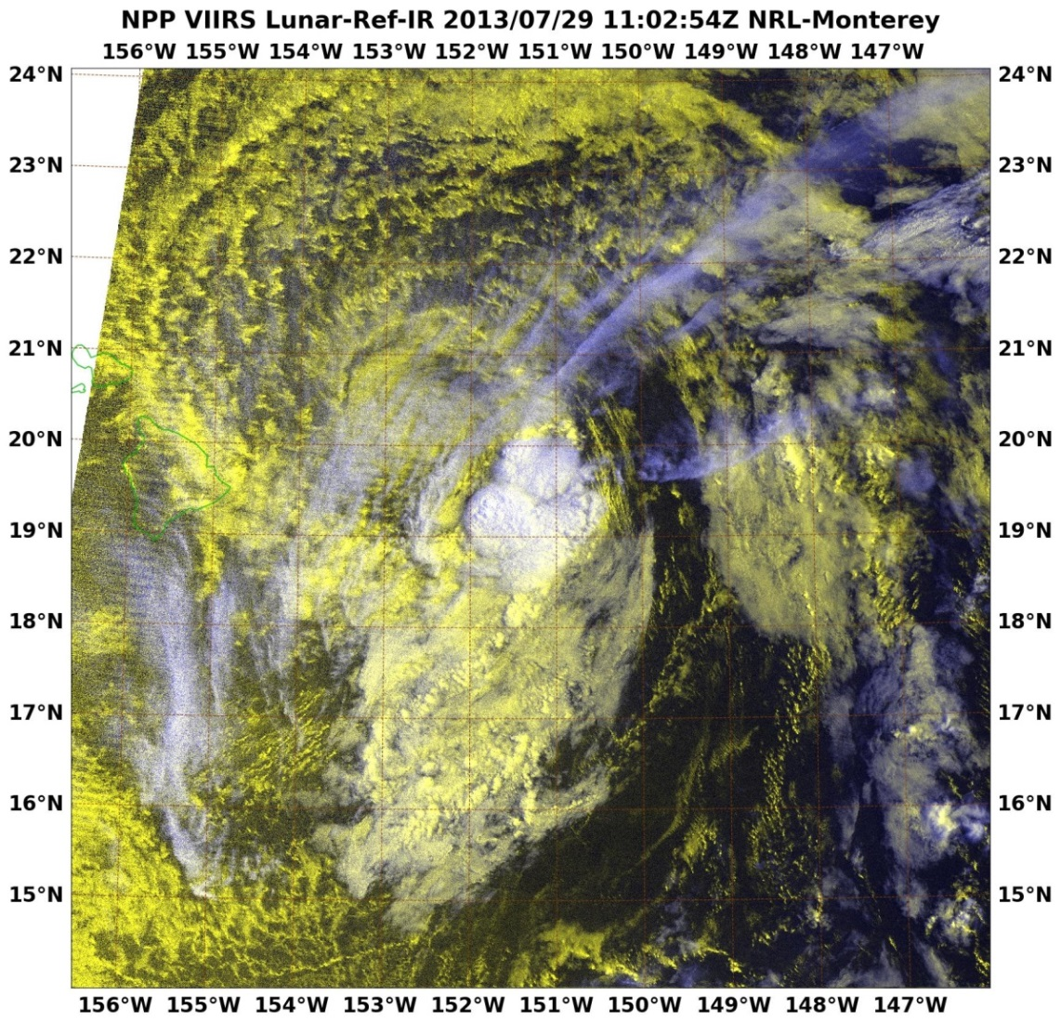
Nighttime TC Monitoring via DNB
60 nm
VIIRS DNB dramatically altered CPHC Flossie forecast to the NW, directly impacting landfall and day 1-3 day warnings

Slide 18
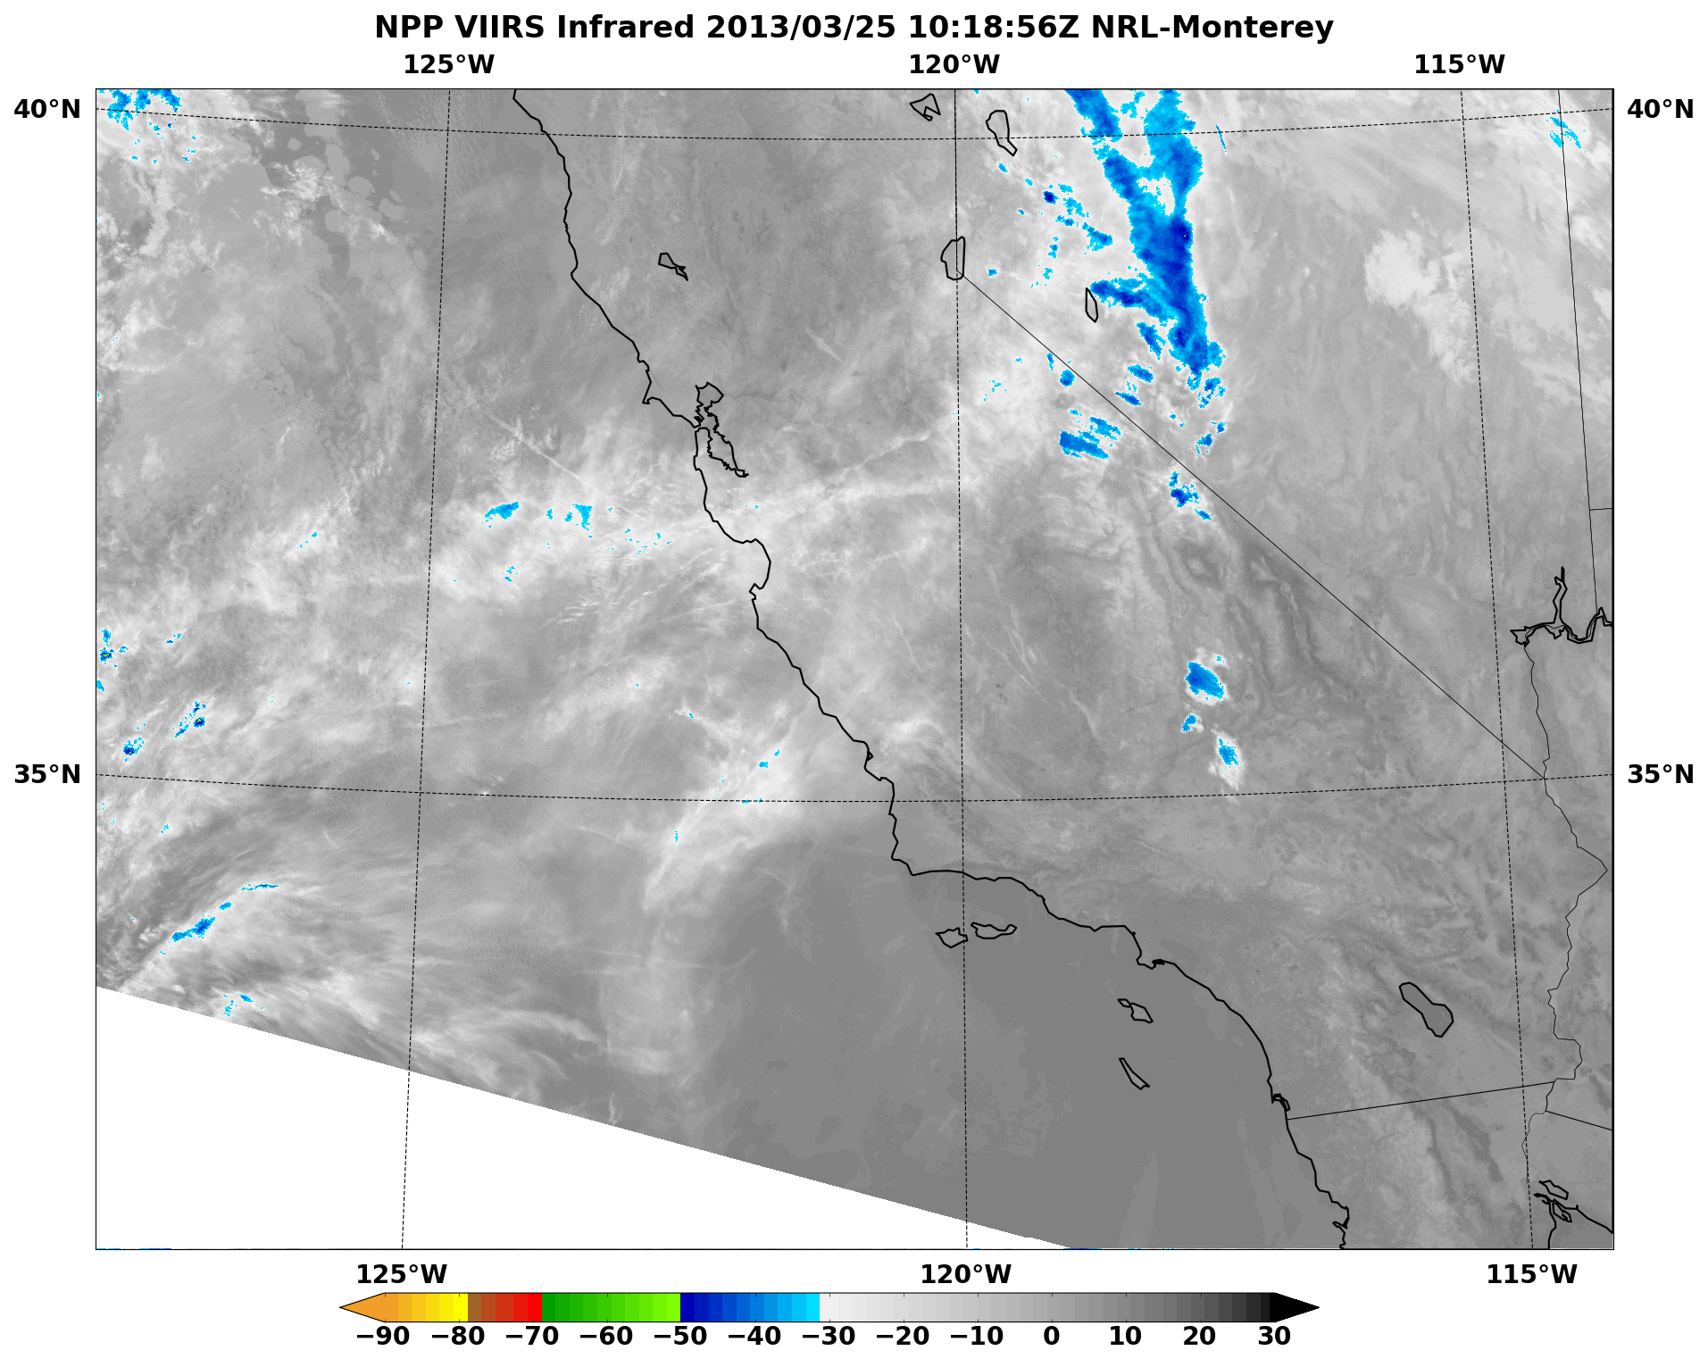
Low Cloud and Fog

Slide 19
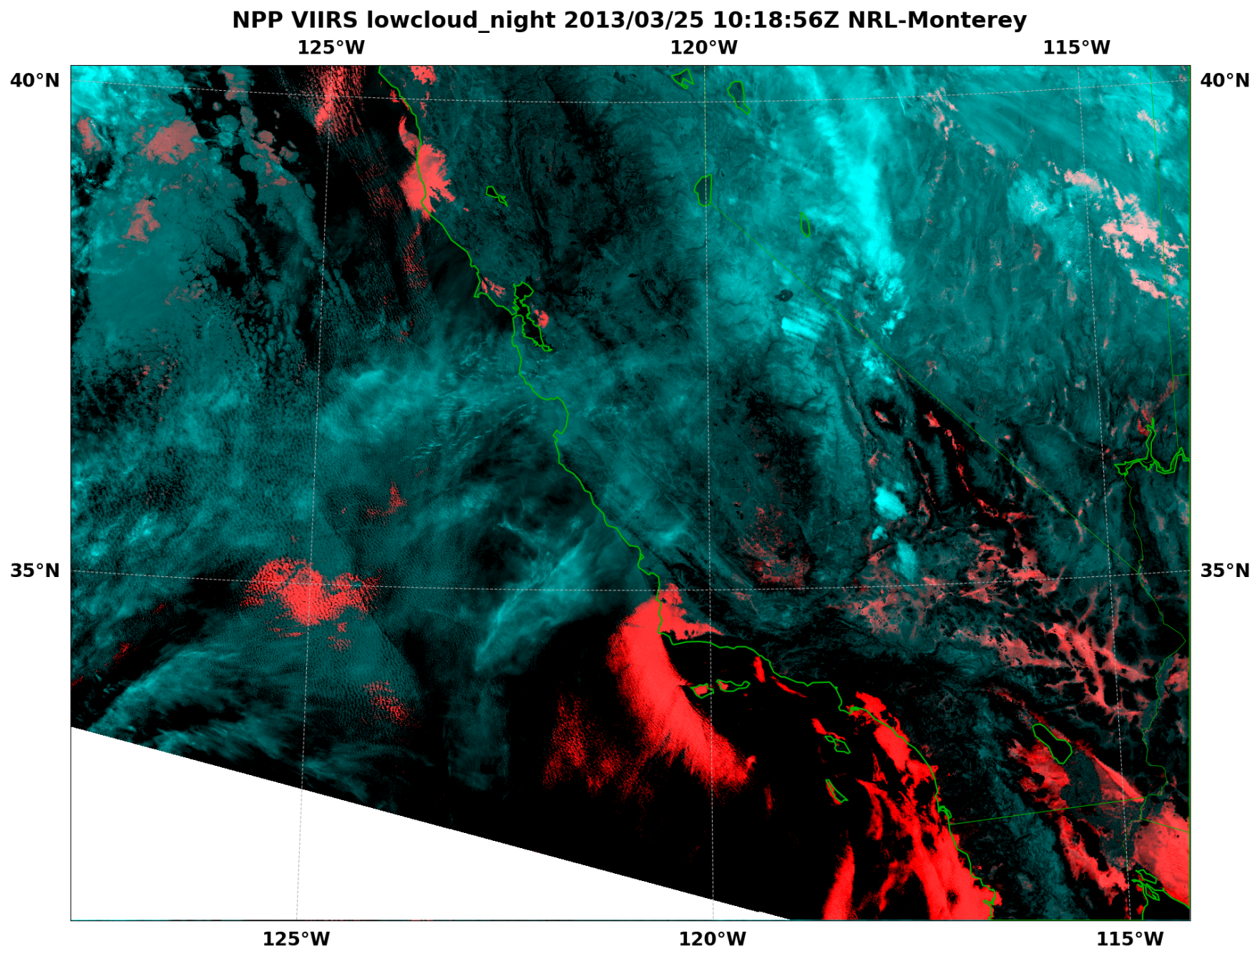
Low Cloud and Fog

Slide 20
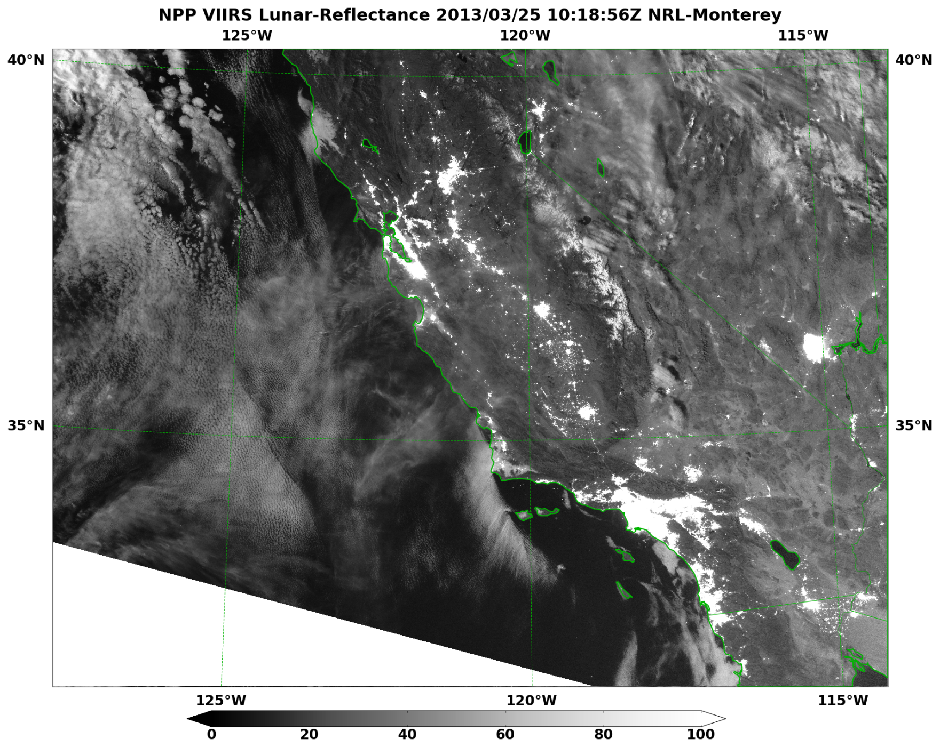
Low Cloud and Fog

Slide 21
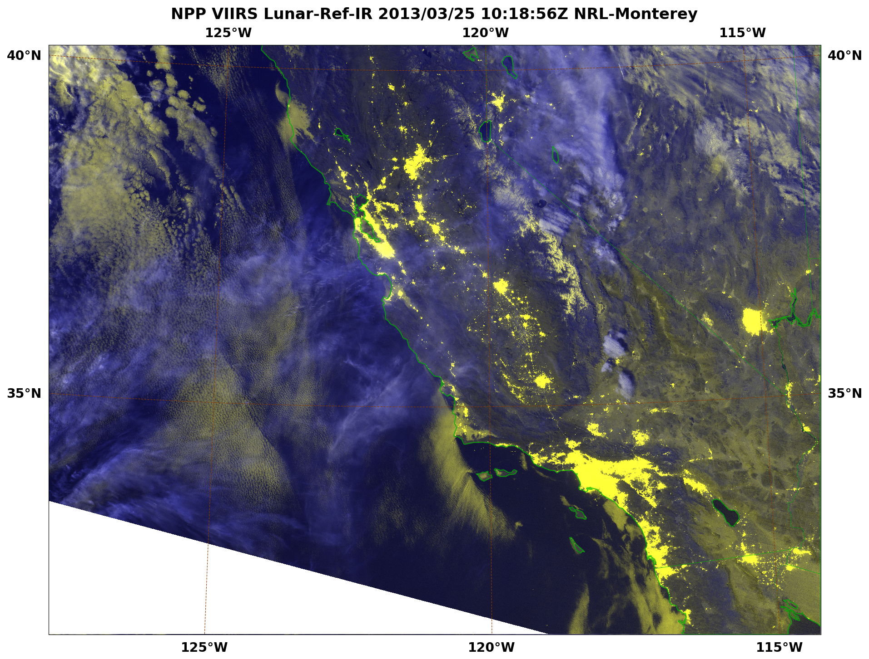
Low Cloud and Fog

Slide 22
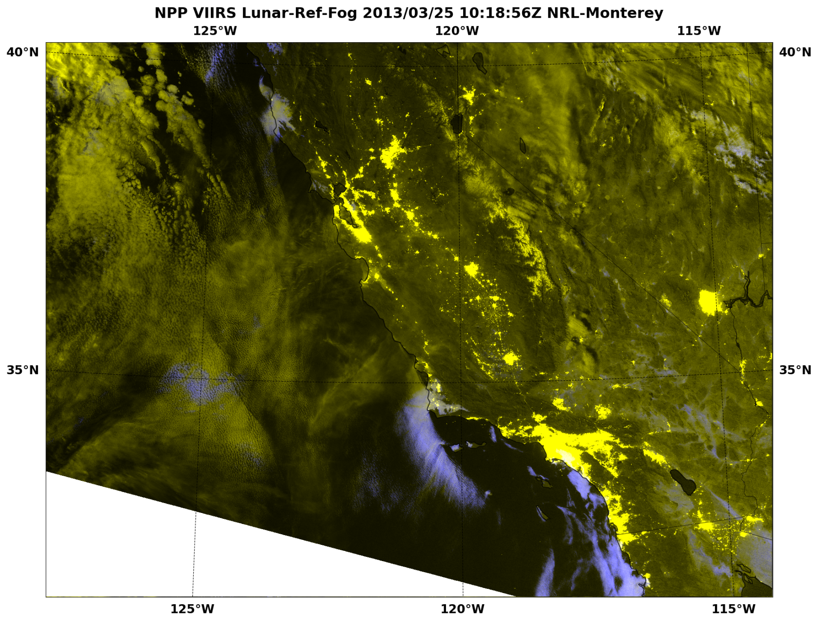
Low Cloud and Fog

Slide 23
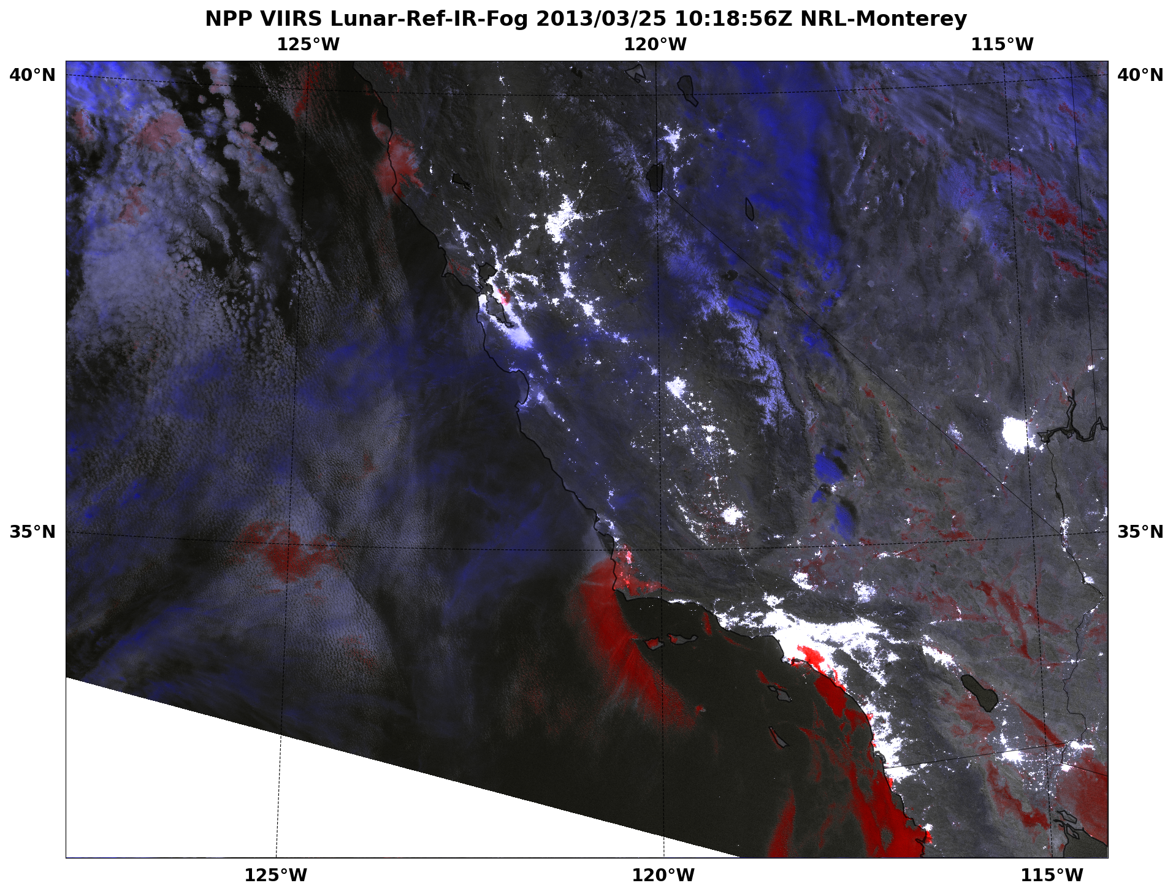
Low Cloud and Fog
High cold cloud
Snow cover
Low cloud
Large droplets
Cirrus obscured low cloud
Low cloud
Small droplets

Slide 24
DNB For Nighttime Sea Ice
Chukchi
Sea
Clouds
Lunar illumination passes through thin cirrus and reflects off sea ice below
RUSSIA

Slide 25
DNB For Nighttime Sea Ice

Slide 26
Great Lakes Ice Demo
NIC
Great Lakes Lake Ice Map
May 23, 2014
< 1/10 (light blue), isolated lake ice near south shore and Michipicoten Island

Slide 27
Great Lakes Ice Demo
Lake Ice
VIIRS True Color Animation
May 23-30 , 2014
Created Great Lakes VIIRS sea ice demo within 15 minutes of NIC request using GeoIPS software

Slide 28
Summary
Currently operationally assimilating ATMS
Assimilation of CrIS and OMPS is currently in development
Many VIIRS imagery products are available on public webpages, collocated with imagery from heritage sensors (GOES, MODIS, DMSP, ...)
www.nrlmry.navy.mil/NEXSAT.html
www.nrlmry.navy.mil/VIIRS.html
http://www.nrlmry.navy.mil/tc_pages/tc_home.html
Several VIIRS imagery products have been successfully transitioned to Navy operations
VIIRS products actively being used by operational centers (JTWC, NIC, ...)

